Slide 1

SafePath Project
Group 2
D24125555 – Hina Kausar – Team Lead
D24126048 – Shalini Kuruguntla
D24125575 – Sai Priyanka Basa Shanker
D24126339 – Huda Ibrahim
D24127853 – Karan Joseph

Slide 2
Leadership Overview – Week 4
Tasks Completed this Week:
• Finalize all required group deliverables for sprint 2.
• Managed Jira board and assign the task for smooth progress.
• Ensure GitHub repository and PM Challenge material are complete and organized.
• Updated Personas to reflect real user behaviour and safety needs.
• Refined Prototype to ensure consistent, accessible UI design.
• Technical Architecture for clear system component interactions.
• Research and collect academic papers for the project
• Data collection and preparing plan for data cleaning
• Coordinated planning for next week’s activities.
• Finally finalized on the datasets and give priority to pedestrians over cyclists.

Slide 3
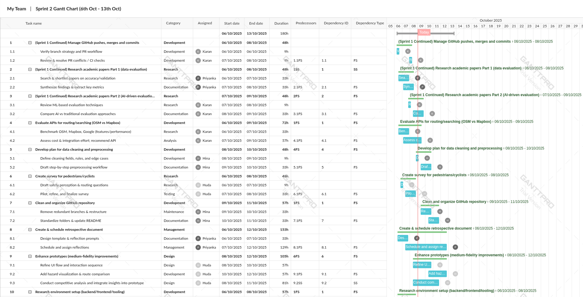
Project Planning – Sprint 2 Gantt Chart (part 1)

Slide 4
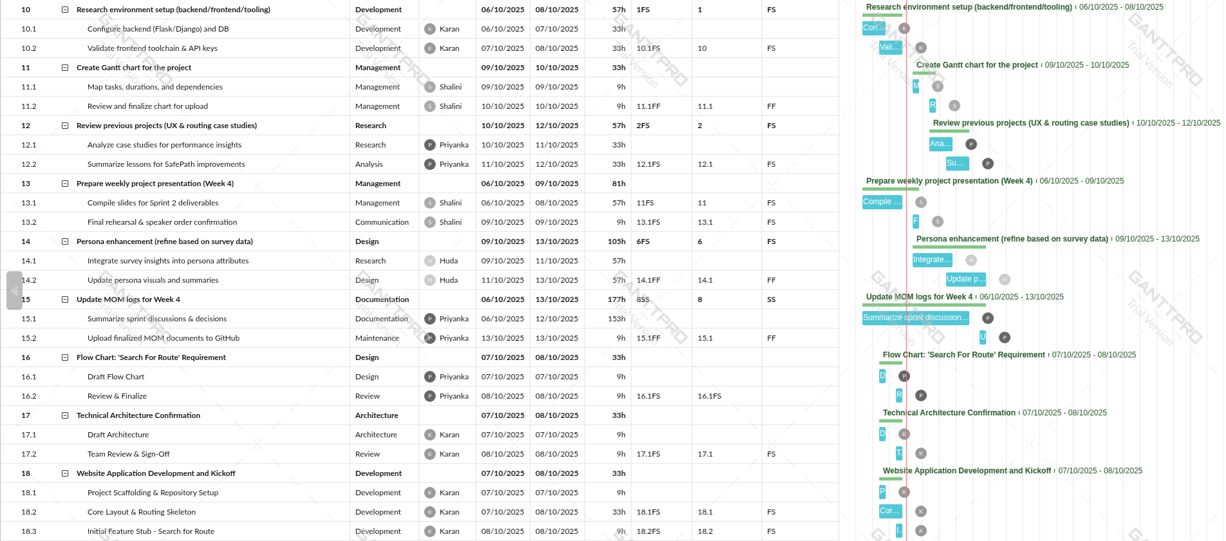
Project Planning – Sprint 2 Gantt Chart (part 2)

Slide 5
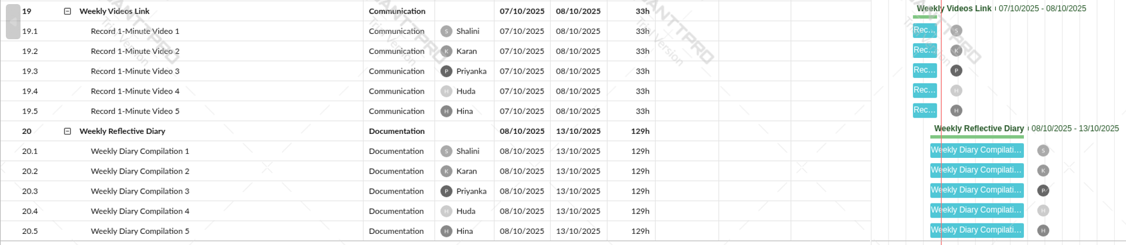
Project Planning – Sprint 2 Gantt Chart (part 3)

Slide 6
Data Collection & Research Sources
1. Accidents & Road Safety 🚗 / ⚠️
UK Road Accidents (Data.gov.uk): All police-reported accidents with location, severity, and casualty type.
Transport for London (TfL): Collisions on roads managed by TfL.
2. Cycling & Walking Infrastructure 🚴‍♂️ / 🚶
TfL Open Data Portal:
Cycle Superhighways, Quietways, Santander Cycle hire stations, Walking routes
London Data Store – Cycle Infrastructure: Cycle lanes, tracks, and shared paths
3. Crime Data 🛡️ / 👮
Metropolitan Police Open Data: Monthly crime data with categories, outcomes, and GPS coordinates
4. Air Quality 🌫️ / 🏭
London Air Quality Network (LAQN): PM2.5, PM10, NO₂ from roadside stations
DEFRA UK Air Quality Archive: Historical and real-time readings
5. Street Lighting & Environment 💡 / 🏙️
London Datastore – Street Lighting: Locations of street lights
OpenStreetMap (OSM): Lighting, crossings, sidewalks, cycleways, etc.
6. Weather Data ☀️ / 🌧️
Met Office DataPoint: Weather forecasts and historical observations (API)

Slide 7
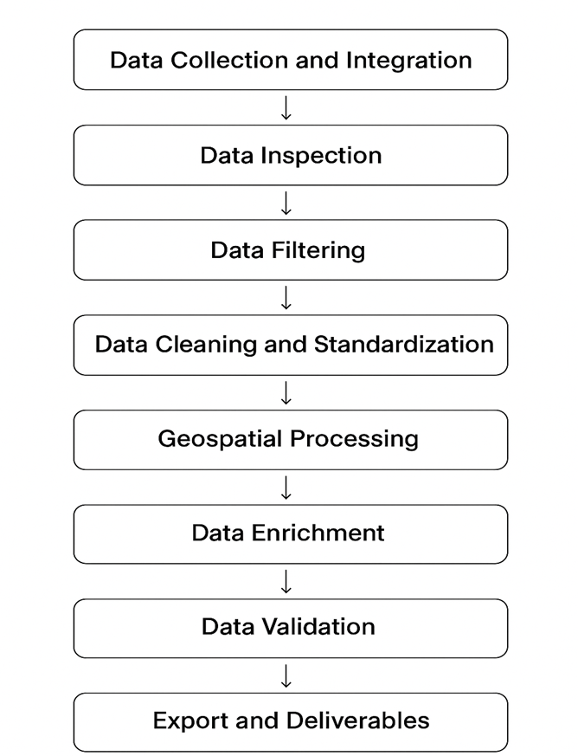
Planning steps for Data Cleaning: Flow Chart

Slide 8
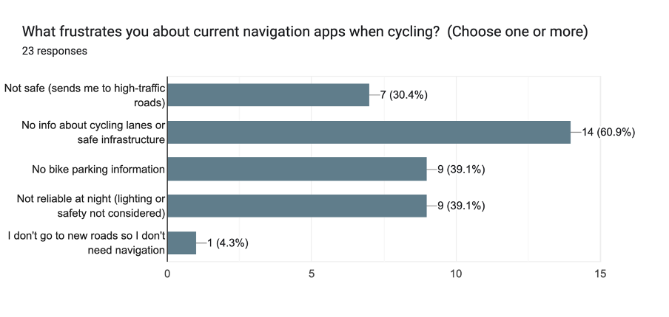
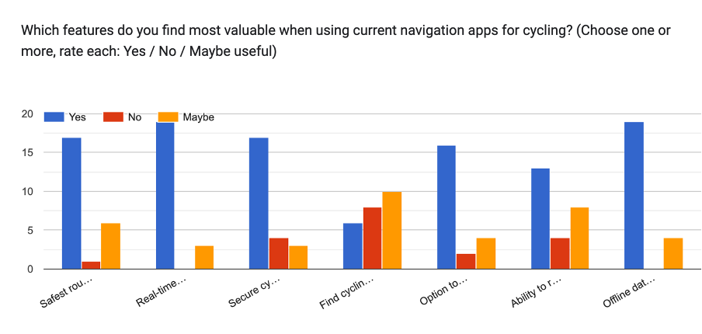
UX Research – Survey Cyclists
Key Findings:
91% are beginners or intermediate riders → focus on ease and confidence.
Top frustrations:
Lack of info on cycle lanes/safe infrastructure (61%)
Missing bike parking and night safety features (~39%)
Desired features: real-time hazard alerts, secure parking, and offline data.
75% prefer safest routes over fastest.
96% would use cycle parking finder.
75% open to connecting with others if privacy is protected.

Slide 9
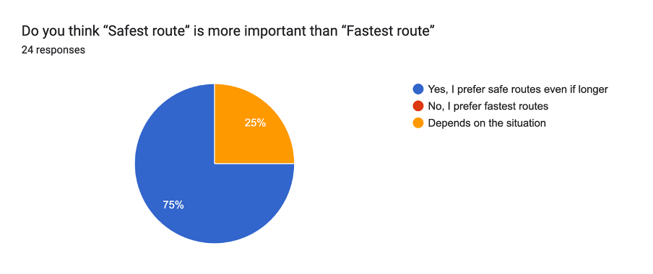
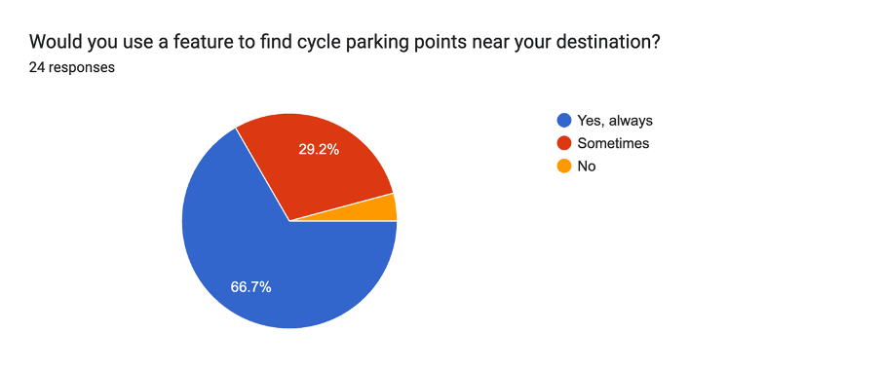
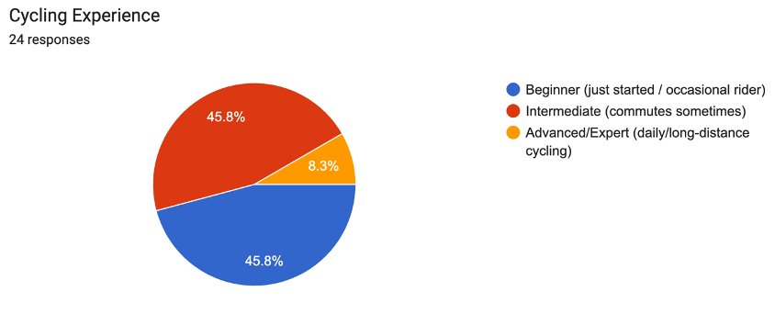
UX Research – Survey Cyclists

Slide 10
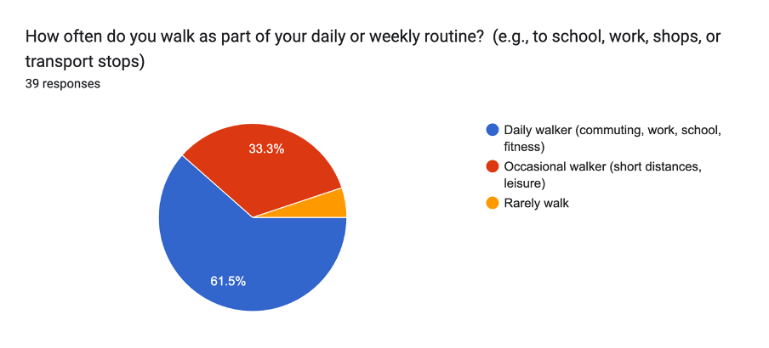
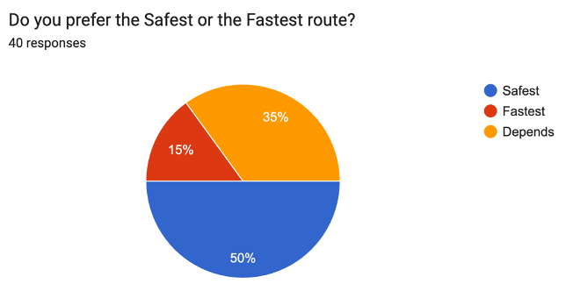
UX Research – Survey Pedestrians
Pedestrian Insights (40 responses)
Main Takeaways:
61% walk daily; walking is part of routine mobility.
Top frustrations:
No hazard alerts (50%), poor lighting info (45%), and lack of safety awareness (39%).
Most valuable SafePath features:
Safe routes (61%)
Real-time safety alerts (61%)
Safer crossings (50%)
85% prefer safe or context-based routes over fastest.
100% open to real-time alerts (with smart control).
75% open to connecting with walking groups (if privacy protected).
73% willing to report hazards, supporting community-driven safety.

Slide 11
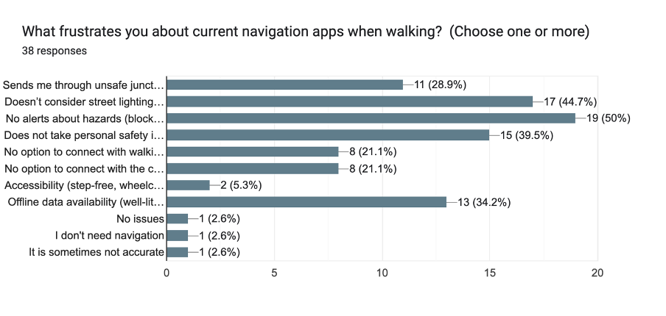
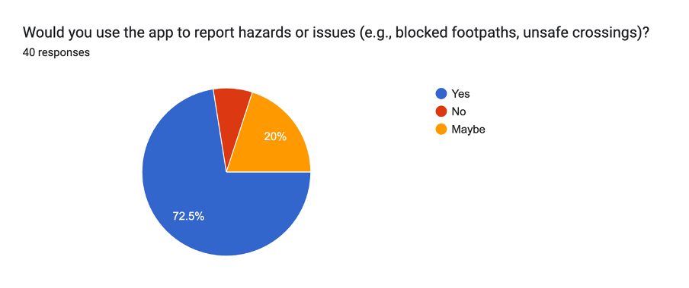
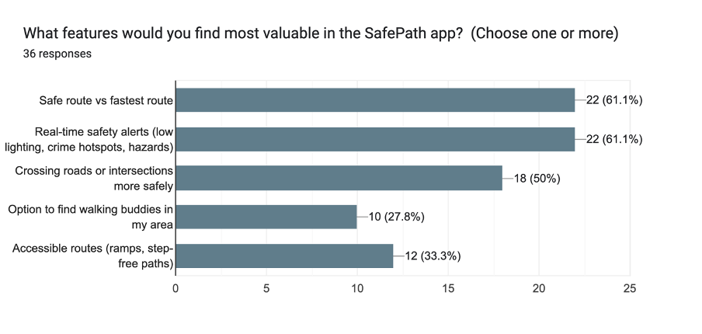
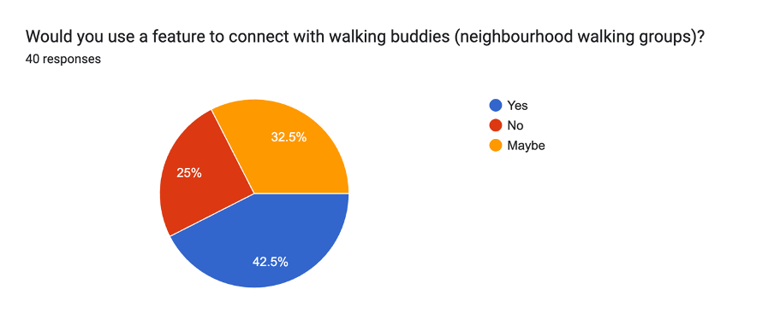
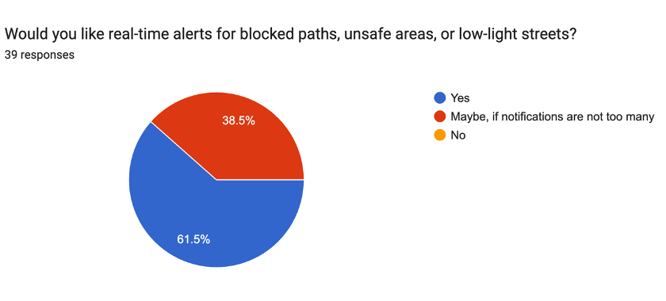
UX Research – Survey Pedestrians

Slide 12
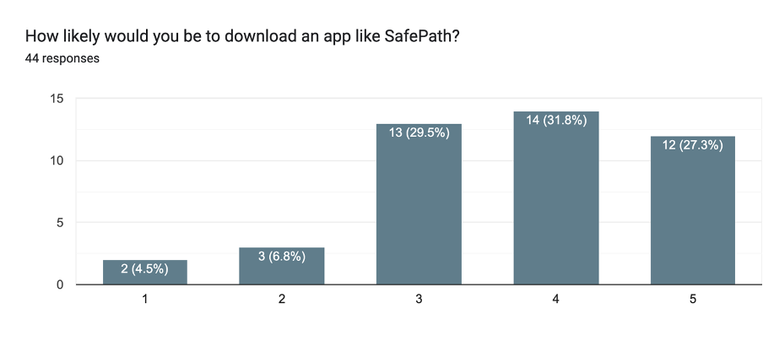
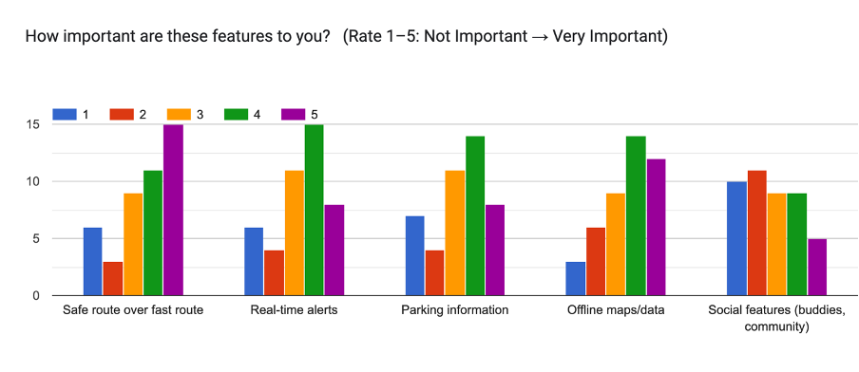
UX Research – Survey All Users
Main Takeaways:
Preferred alert type: non-intrusive — 41% only when app is open, 34% push notifications.
Most important features: Safe routes, real-time alerts, offline maps.
59% likely or very likely to download SafePath; 90% positive or neutral overall.
Encouraging factors:
Free to use (82%)
Unique safety features (52%)
Trust from local councils or universities (32%)
Awareness channels:
Social media (59%) and friends’ recommendations (55%) are key.

Slide 13
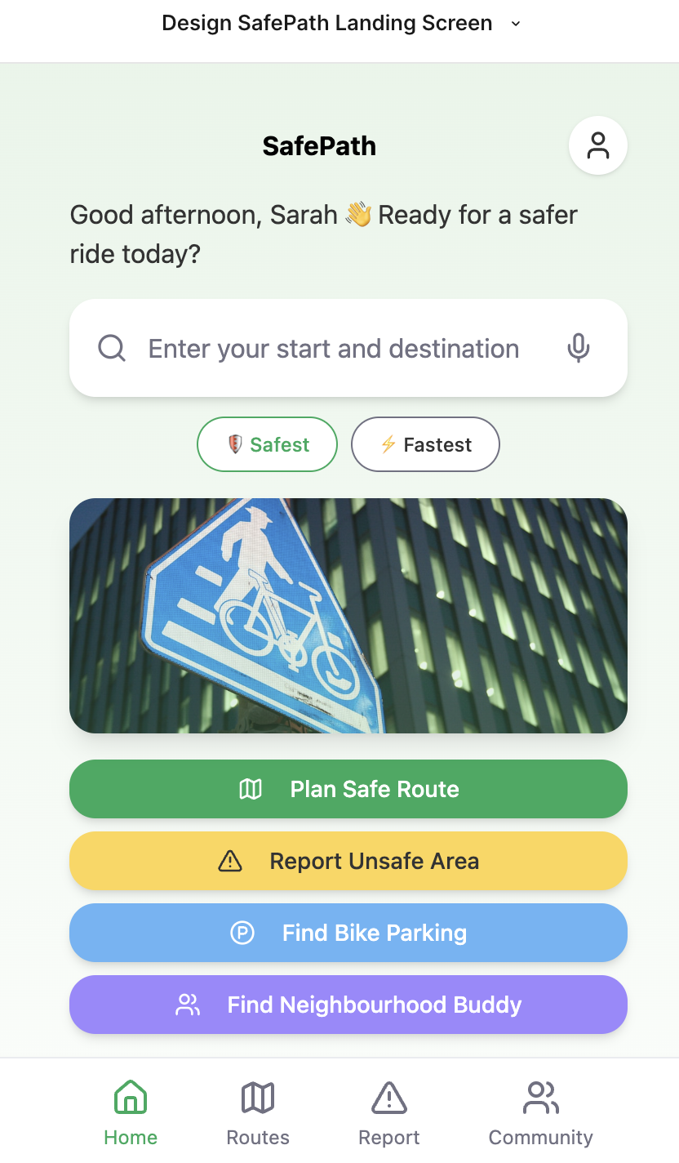
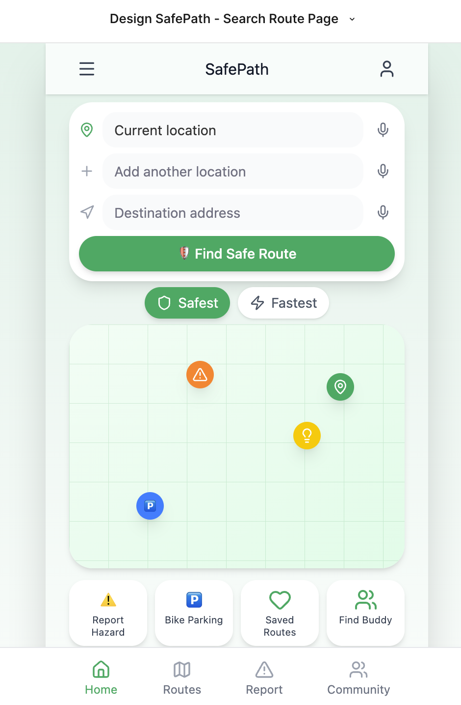
Prototype Enhancement – Medium-Fidelity Improvements

Slide 14
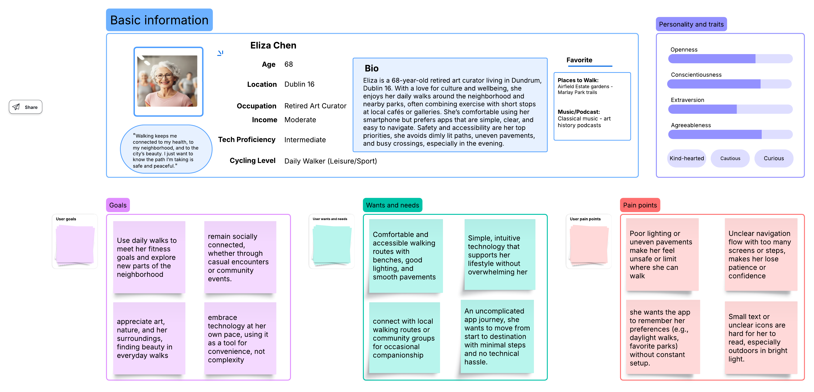
Persona Enhancement – Daily Walker

Slide 15
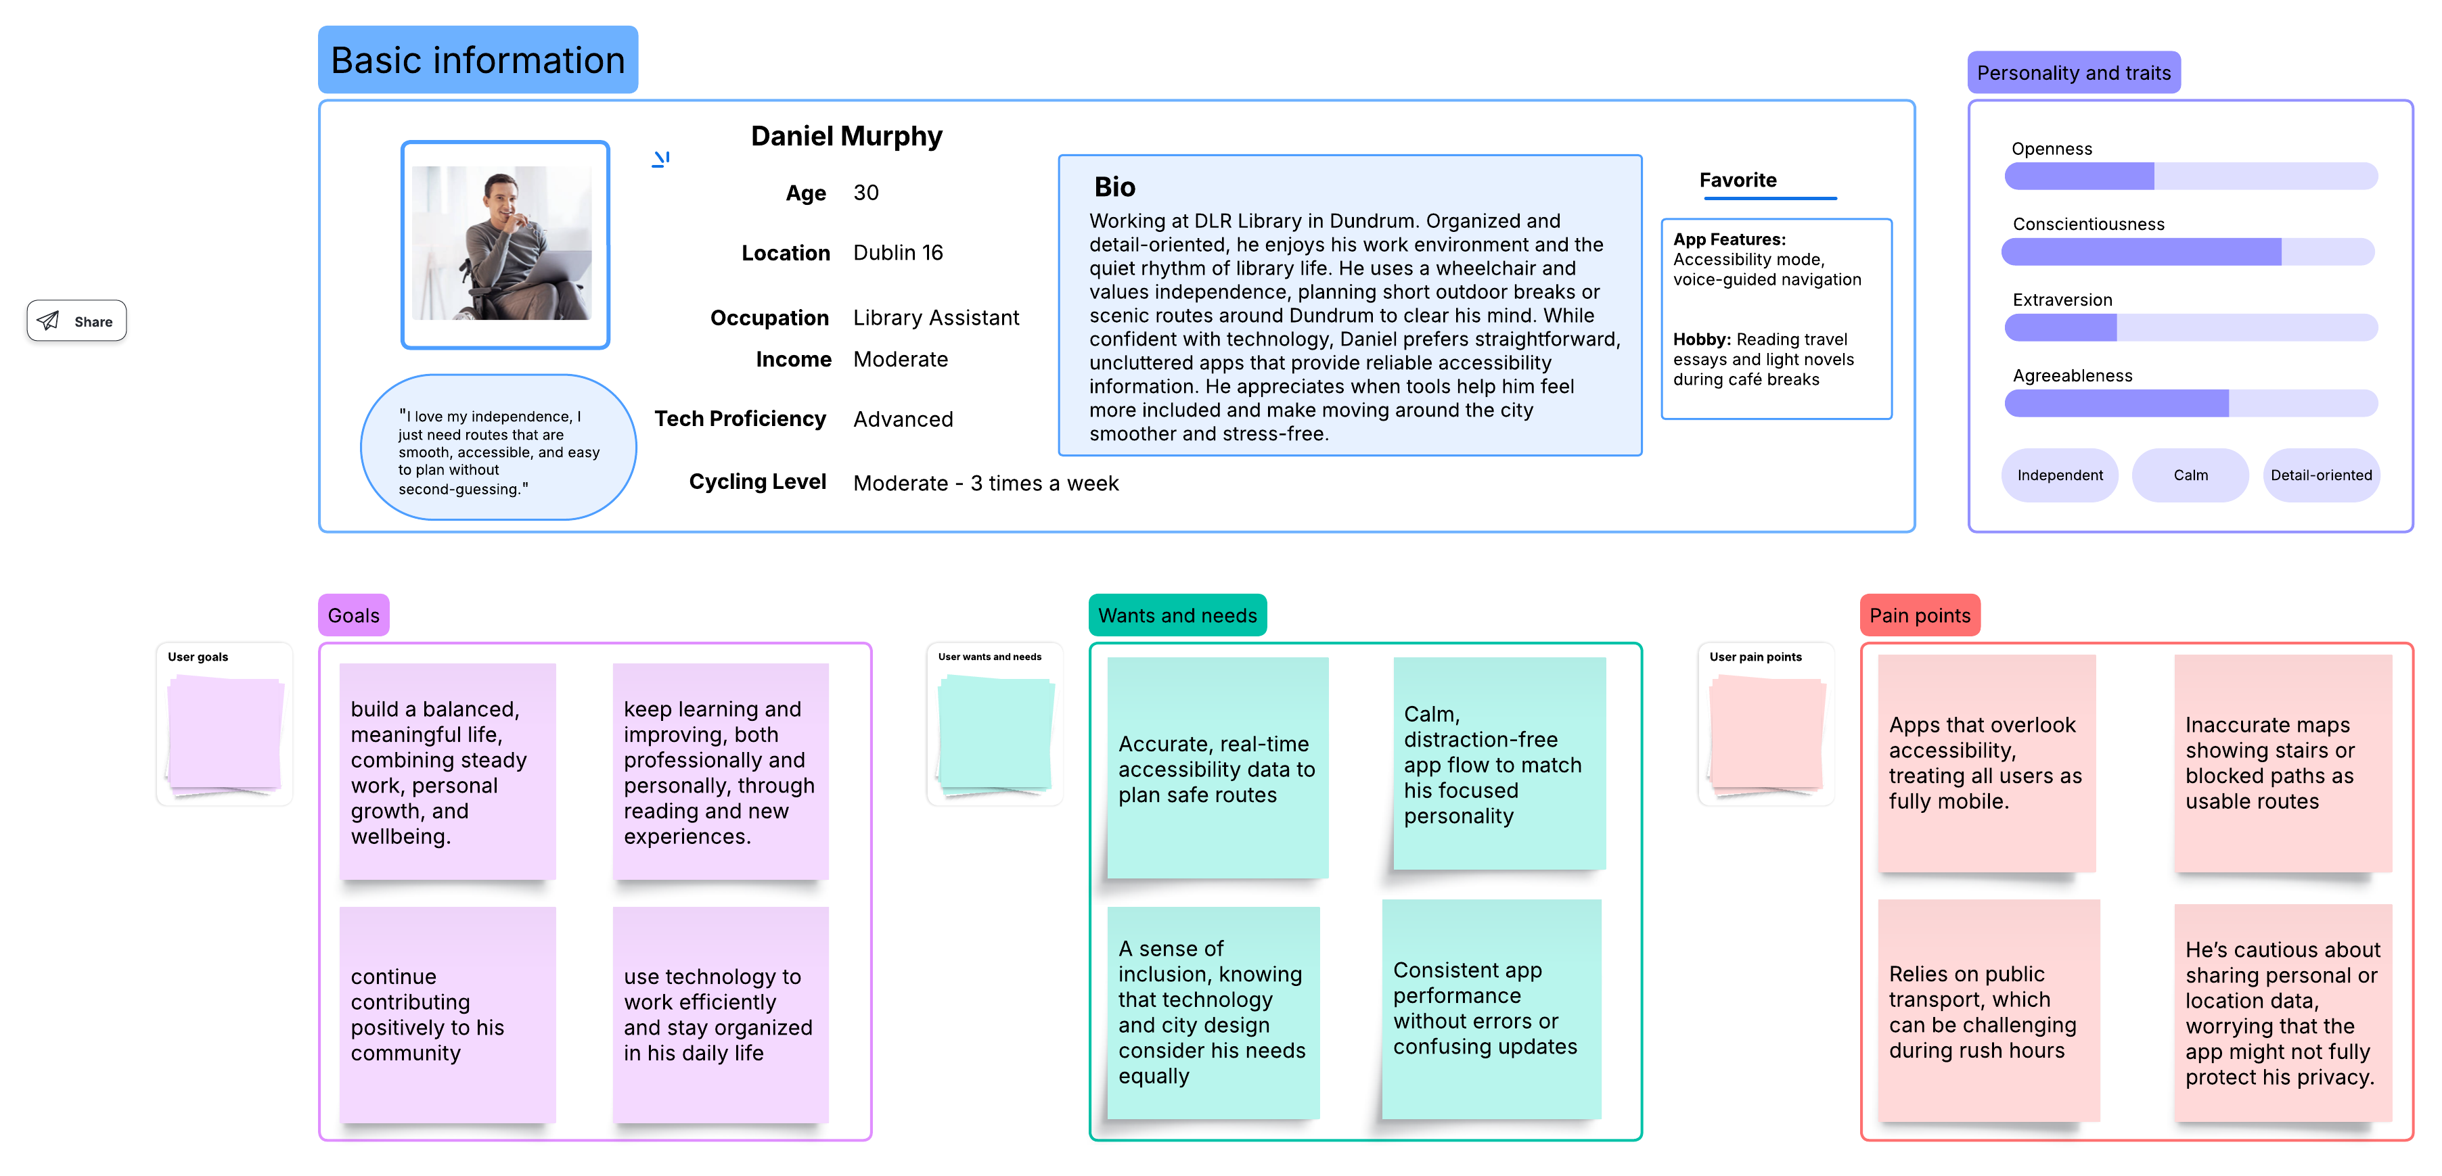
Persona Enhancement – Wheelchair Pedestrian

Slide 16
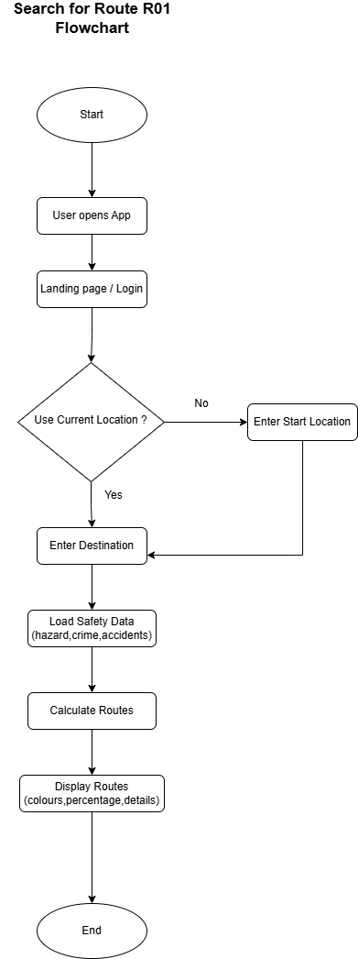
System Flow Chart
Search for Route’ Requirement

Slide 17
Technical Architecture Confirmation

